Slide 1
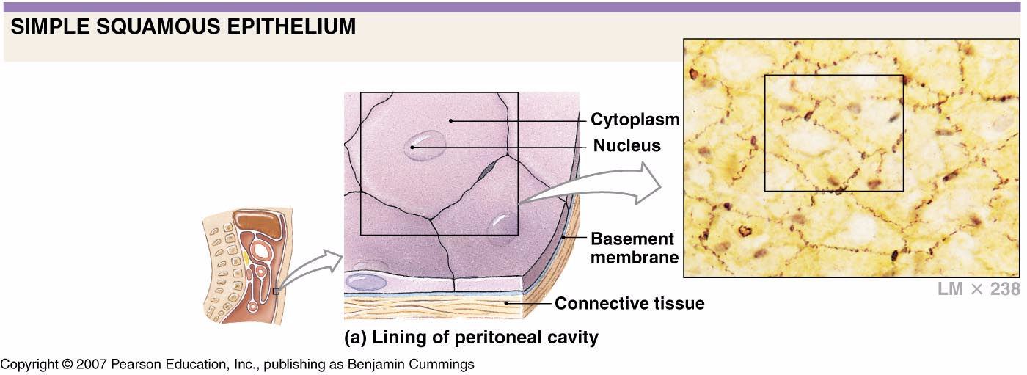

Slide 2
A. Simple Squamous Epithelium
1 layer, squamous cells
on a basement membrane
Rapid diffusion
Found in air sacs of lungs, walls of capillaries, serous membranes (slick membranes that line the body cavity and organs)

Slide 3
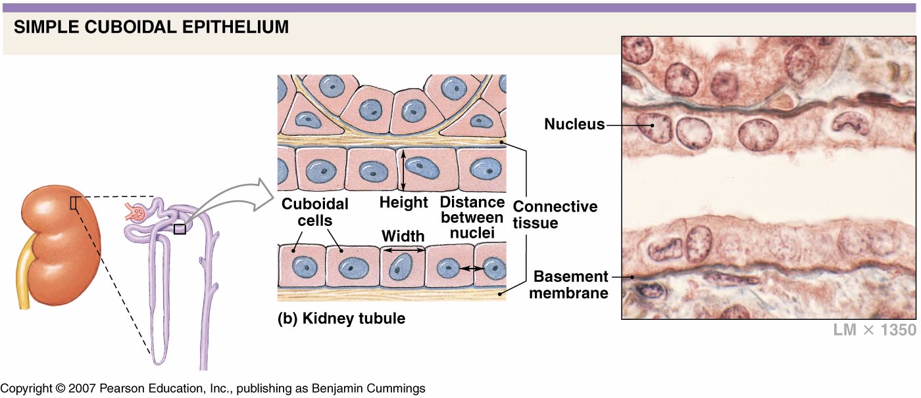

Slide 4
B. Simple cuboidal epithelium
1 layer, cuboidal cells on basement membrane
Secretion or absorption
Found in glands and their ducts
  Example: salivary glands, pancreas

Slide 5
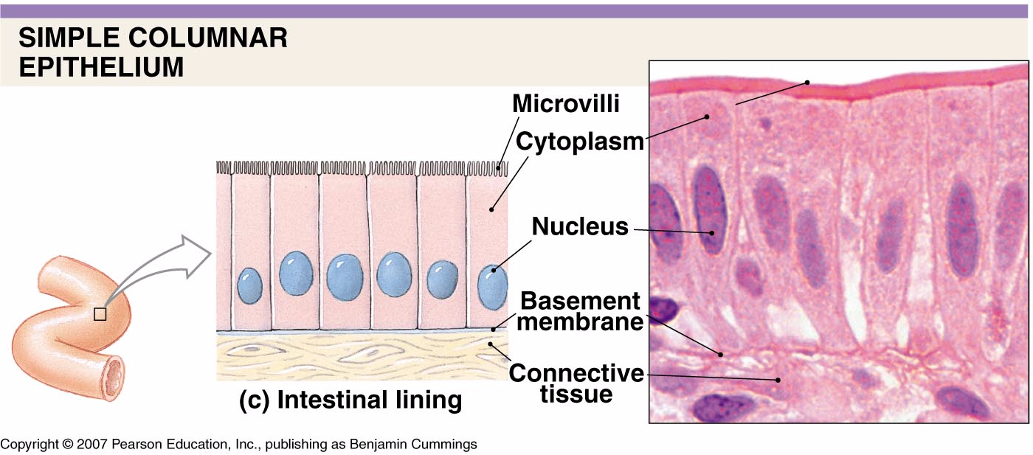

Slide 6
C. Simple columnar epithelium
1 layer, columnar cells
Secretion/absorption
fit closely together
Goblet cells found here (produce mucus)
Lines the digestive tract from stomach to anus and forms mucus membranes

Slide 7
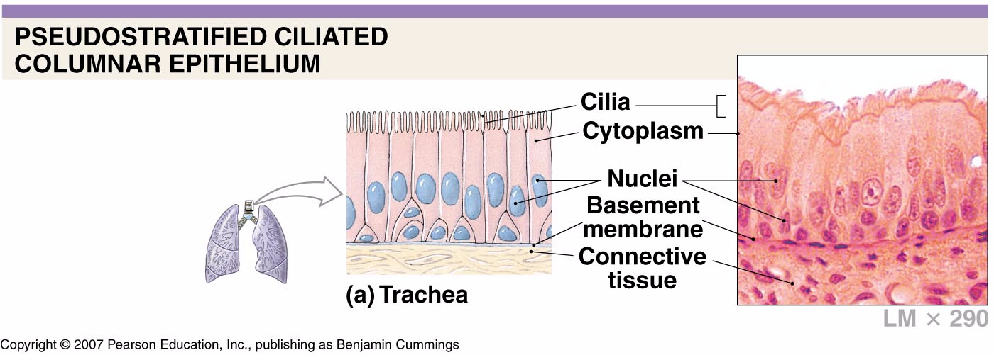

Slide 8
D. Psuedostratified columnar epithelium
All cells rest on basement membrane.
Looks stratified, but isn’t
absorption and secretion

Slide 9
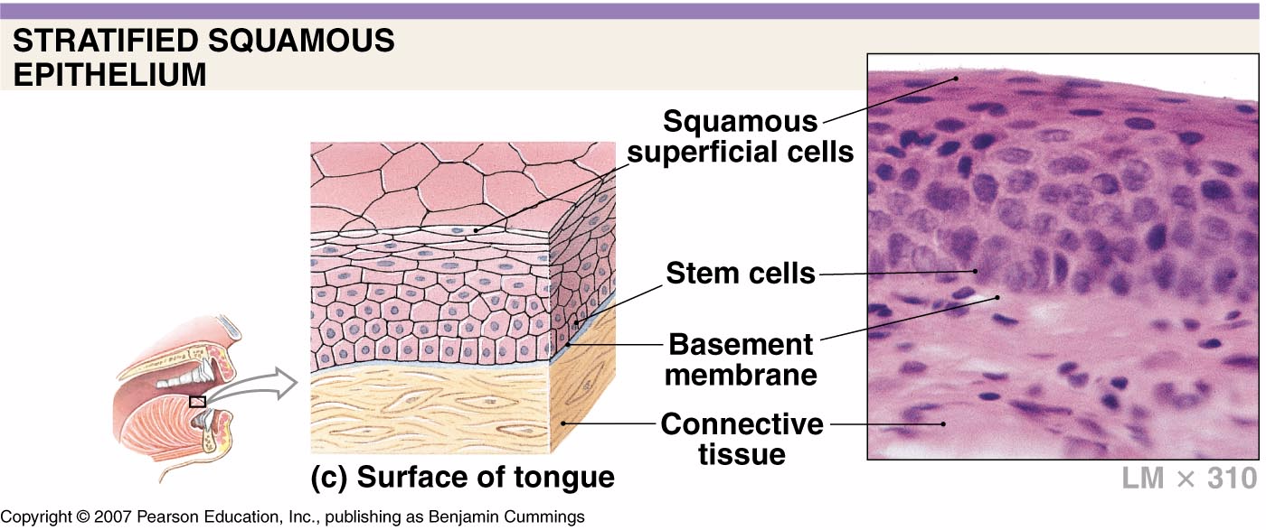

Slide 10
E. Stratified squamous epithelium
protection
Free edge are squamous cells
cells close to basement membrane are cuboidal or columnar.
High use areas such as esophagus, mouth, outer skin

Slide 11
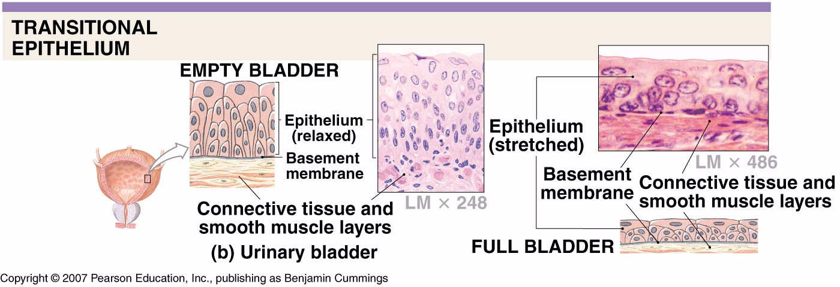

Slide 12
G. Transitional epithelium
Cells can change shape when stretched in urinary bladder.

