Slide 1
Nervous System Jeopardy
Round 1
Round 2

Slide 2
Round 1
Neurons | Electrical States of Neurons | Types of Nervous Systems | Sensory Receptors & Chemicals | Control of Functions in the Brain | Other Components of the Nervous System
100 | 100 | 100 | 100 | 100 | 100
200 | 200 | 200 | 200 | 200 | 200
300 | 300 | 300 | 300 | 300 | 300
400 | 400 | 400 | 400 | 400 | 400
500 | 500 | 500 | 500 | 500 | 500
Final Jeopardy Round 1
Round 2

Slide 3
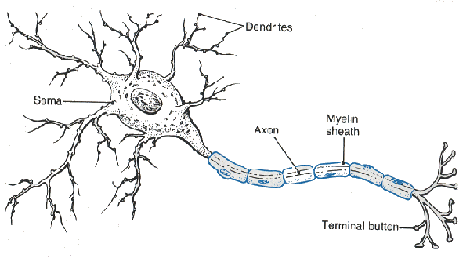
What are the two parts of a neuron specifically designed for the sending and receiving of electrical impulses?
Dendrite – Receiving
Axon – Sending
Round 1

Slide 4
Which type of neuron receives the initial stimulus?
Sensory Neuron
Exs. Eye stimulated by light,
Hand stimulated by touch
Round 1

Slide 5
What do motor neurons stimulate?
Effectors, or target cells that produce some kind or response
Ex. Stimulate muscles to create movement
Round 1

Slide 6
What type of neurons are found in the brain and spinal cord?
Interneurons
Receive impulses from sensory neurons or send impulses to motor neurons
Round 1

Slide 7
The classification of neuron that has a single axon and many dendrites?
Multipolar
Round 1

Slide 8
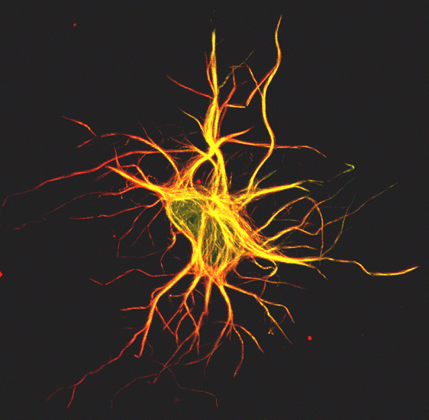
The charge inside the neuron at resting membrane potential?
Negative
Round 1

Slide 9
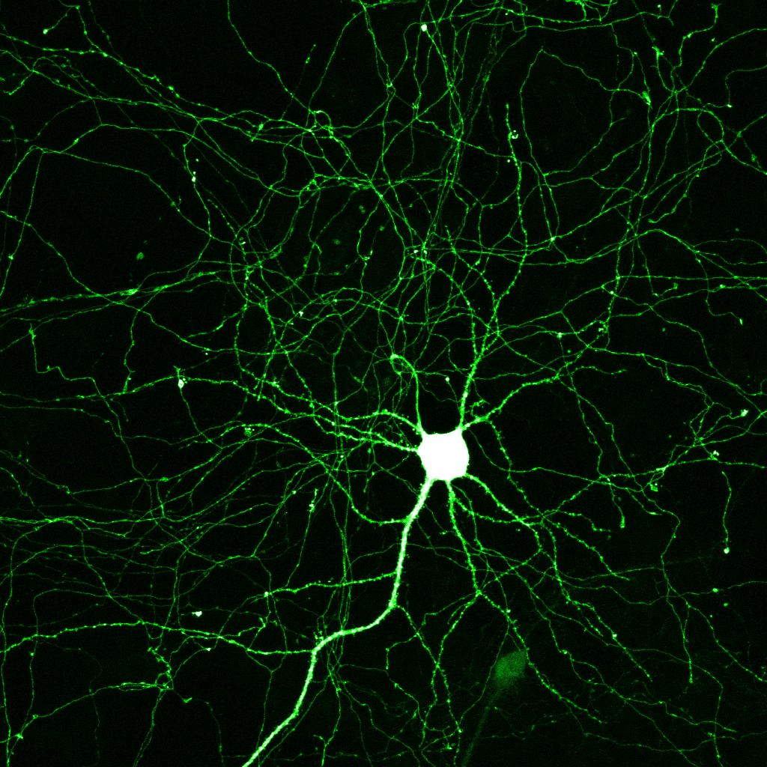
The first ion to move across the cell membrane during an action potential? Which way does it move?
Sodium (Na) ions move into the cell.
The move through diffusion and attraction of opposite charges.
Round 1

Slide 10
After Sodium moves into a cell during an action potential, what ion moves next and in which direction?
Potassium (K+) ions move out of the cell.
This causes the cell to become negative inside once again. (Stops the action potential)
Round 1

Slide 11
What process uses energy to reset the ions on both sides of the cell membrane?
The sodium-potassium pump.
It pumps sodium back out and potassium ions back into the cell. The cell cannot have another action potential until this is complete (refractory period).
Round 1

Slide 12
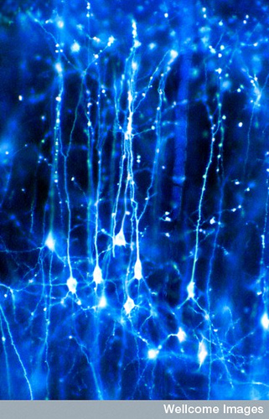
What is the refractory period?
the membrane is polarized but the K+ and Na+ are on the wrong sides of the membrane
the neuron will not respond to a new stimulus during this period and the ions will return to their resting potential to receive a stimulus
Round 1

Slide 13
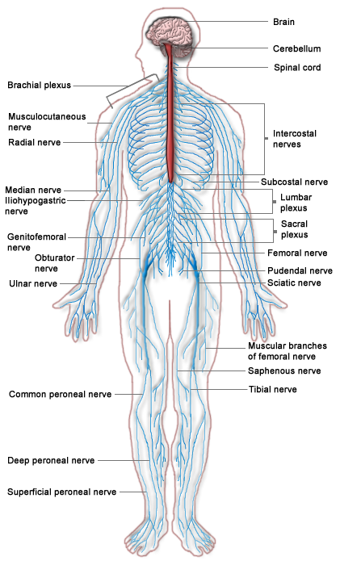
What are the 2 main division of the Nervous system?
The CNS & the PNS.
Round 1

Slide 14
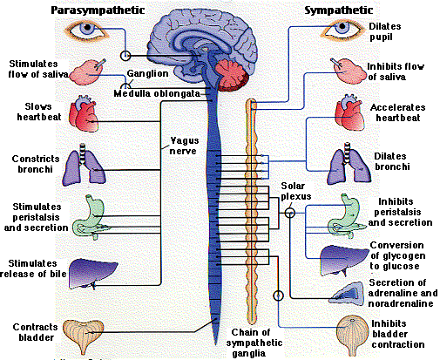
Of what does a central nervous system consist?
  a brain and a spinal cord
Round 1

Slide 15
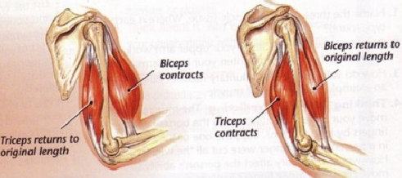
What does the somatic nervous system do?
  It contracts the skeletal muscles
Round 1

Slide 16
What does the autonomic nervous system control?
controls the activity of organs and various involuntary muscles
Ex. Cardiac and Smooth
Round 1

Slide 17
What are the two divisions of the autonomic nervous system?
  the sympathetic and parasympathetic divisions
Round 1

Slide 18

What chemical crosses the synaptic cleft and carries messages to the next neuron or effector organ?
Neurotransmitters
Round 1

Slide 19
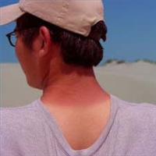
Excess heat, pressure or specific classes of chemicals released from damaged tissues stimulate what kind of receptors?
Pain Receptors (free nerve endings)
Round 1

Slide 20
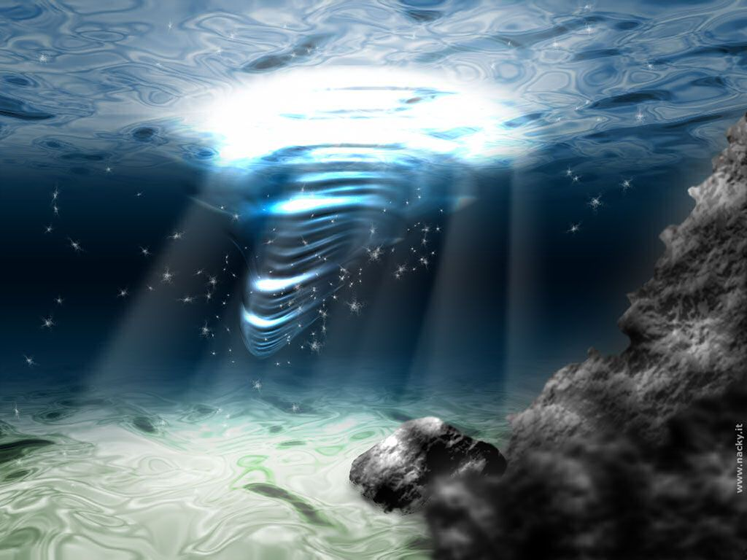
Neurons that carry messages from sense receptors to the CNS are called?
Snesory or afferent neurons
Round 1

Slide 21
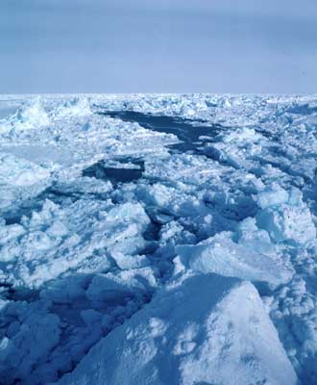
Hot and cold are detected by what kind of receptor?
Thermoreceptors
they also help maintain body temperature
Round 1

Slide 22
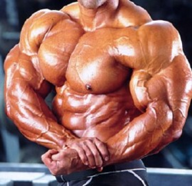
Neurons that carry messages from the CNS to muscles are called?
Motor neurons or efferent neurons
Round 1

Slide 23
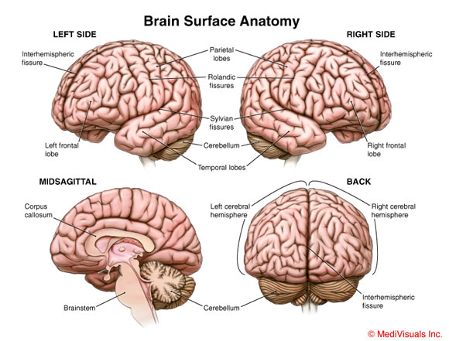
Higher level thinking and decision making is controlled by what part of the brain?
cerebrum
Round 1

Slide 24
The knee jerk reflex is integrated by what part of the CNS?
The spinal cord
Round 1

Slide 25
Thirst, appetite, sex, pain, and pleasure centers are regulated by the…
hypothalamus
The hypothalamus plays a role in the limbic system (emotional brain)
Round 1

Slide 26
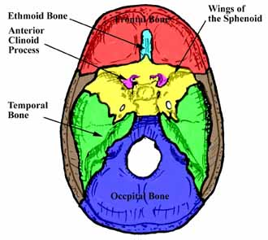
The ability to speak is housed in which structure of the brain?Which hemisphere is it normally located in?
Broca’s area. It is normally located in the left hemisphere.
Round 1

Slide 27
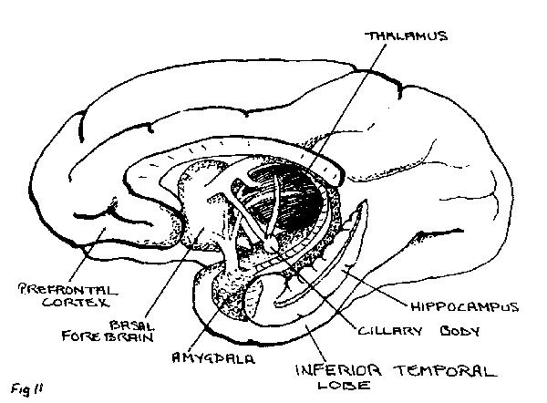
Name two reflexes in addition to the knee jerk reflex.
withdrawal reflex pupillary reflex
gag reflex
salivary reflex
sweating
Round 1

Slide 28
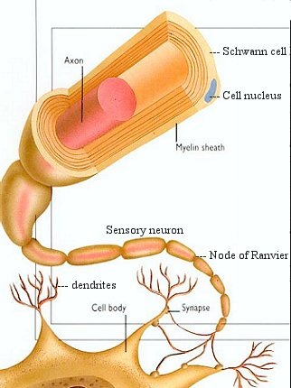
What is a myelin sheath?
glial cells that wrap themselves around the axon of a neuron to insulate it
(Schwann cells in PNS or oligodendrocytes in CNS)
Round 1

Slide 29
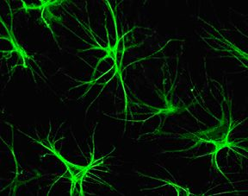
What type of glial cells would be present in a man who has an infection in the brain?
Microglia would be present.
Microglia help kill invaders and get rid of debris in the CNS.
Round 1

Slide 30
What does cerebrospinal fluid do and where is it produced?
cushions the brain and spinal cord, brings the cells nutrients, and washes away wastes.
It is produced by the choroid plexuses found in each ventricle.
Round 1

Slide 31
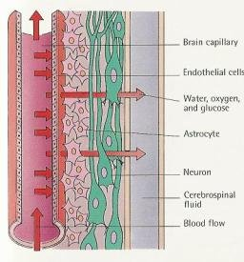
What type of glia cell makes of the blood-brain barrier?
astrocytes
They connect capillaries to neurons.
Round 1

Slide 32
Which type of glial cells form the coverings and line the cavities of the brain and spinal cord?
ependymal cells
Round 1

Slide 33
Final Jeopardy Answer Round 1
Type of cell that is specialized to carry messages.
Round 2
More Review

Slide 34
Final Jeopardy
What is a neuron?
Answer

Slide 35
Round 2
Brain Sections | Brain Sections Continued | Nerves | Vocab | Review Questions | Review Questions Continued
200 | 200 | 200 | 200 | 200 | 200
400 | 400 | 400 | 400 | 400 | 400
600 | 600 | 600 | 600 | 600 | 600
800 | 800 | 800 | 800 | 800 | 800
1000 | 1000 | 1000 | 1000 | 1000 | 1000
Final Jeopardy Round 2
More Review

Slide 36
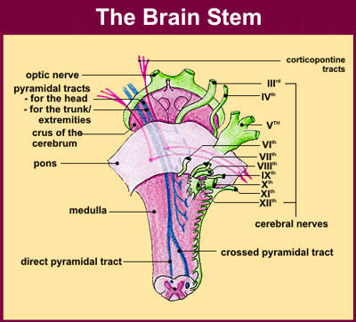
The medulla oblongata, pons, and midbrain are all part of what section of the brain?
The brain stem
This controls functions such as breathing rate, regulates arousal and sleep, and conducts sensory and motor signals between the spinal cord
Round 1

Slide 37
What two types of matter is the cerebrum made out of?
white and gray matter
Round 1

Slide 38
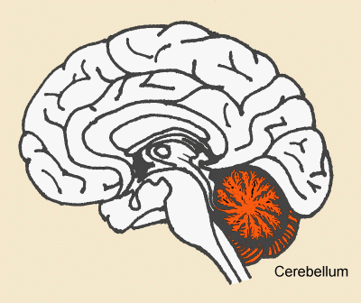
What does the cerebellum control?
Balance, coordination, motor control
Round 1

Slide 39
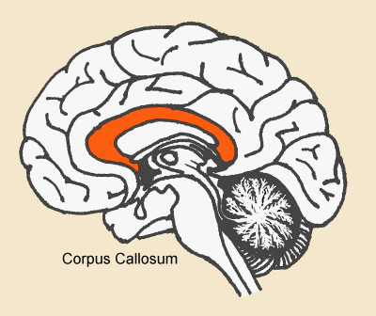
What does the band of axons called the corpus callosum do?
connects the left and right hemispheres of the brain
Round 1

Slide 40
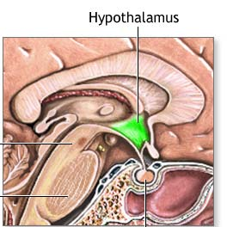
What is the function of the hypothalamus?
regulates homeostasis
This includes the following functions: feeding, fighting, fleeing, and reproducing. It is also a thermostat, an appestat (adjusts appetite), a thirst center, and regulates circadian rhythms.
Round 1

Slide 41
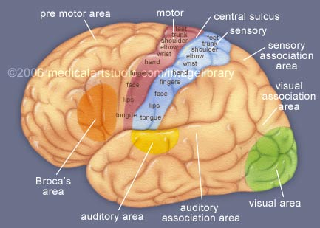
What is the anterior association are responsible for?
socially acceptable behavior
Higher level thinking
Problem solving
Language comprehension
Round 1

Slide 42
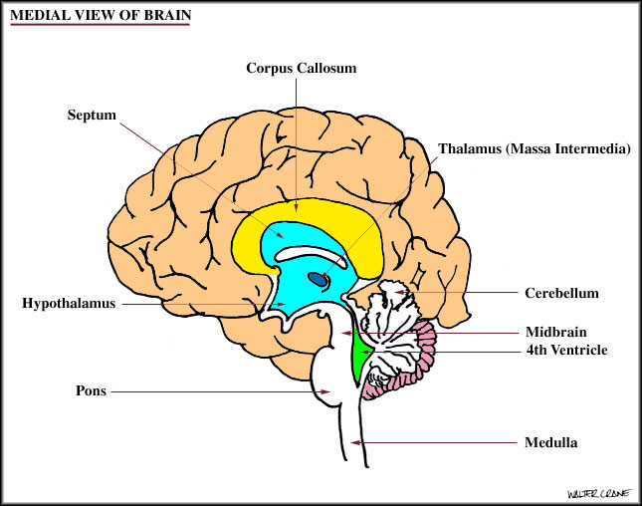
To which part of the brain do the thalamus, hypothalamus, and epithalamus belong?
the diencephalon
Round 1

Slide 43
What is the difference between white and gray matter?
White matter has myelin sheaths surrounding the axons and gray matter contains cell bodies and unmyelinated axons
Round 1

Slide 44
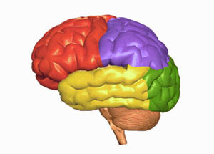
Name and diagram the 4 lobes of the brain. Give a brief function of each.
Frontal: primary motor area; decision making
Parietal: Primary sensory area
Occipital: vision
Temoral: hearing
Round 1

Slide 45
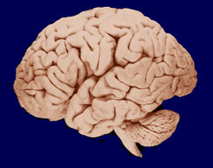
Describe the following features of the cerebrum: gyri, sulci, fissure.
gyri: convolutions, sulci: shallow grooves; fissures: deep grooves
Transverse, Lateral, longitudinal, central sulcus
Round 1

Slide 46
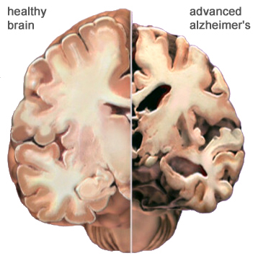
What are the two regions of nerves in the PNS?
Cranial nerves and spinal nerves
Round 2

Slide 47
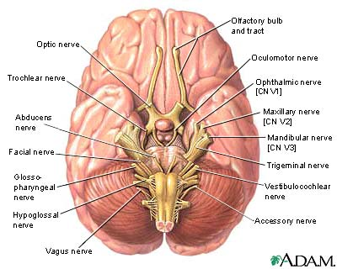
How many cranial nerves are there?
12
Round 2

Slide 48
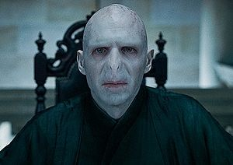
What is one pnemonic device to remember the cranial nerves?
  Oh, oh, oh, to touch and feel very good velvet, ah.
  Ow, ow, ow, to try and fight voldemort. Gee, voldemort’s arms hurt.
Round 2

Slide 49
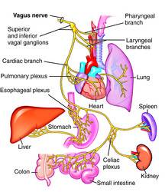
What is the cranial nerve that carries sensory and motor impulses to the visceral organs like the heart and lungs?
The Vagus Nerve (X)
Round 2

Slide 50

Which cranial nerve carries sensory information of smells?
olfactory (I)
Round 2

Slide 51
What parts of the body does the brachial plexus serve?
The arms
Round 2

Slide 52
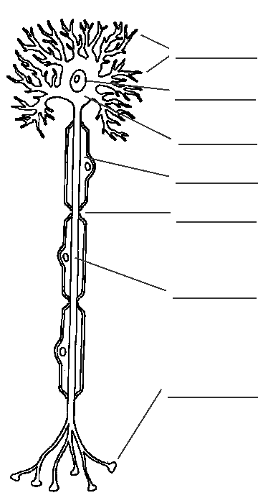
Spaces between myelin sheeths are called…
Nodes of Ranvier
Round 2

Slide 53
Groups of cell bodies found in the PNS are called
ganglia
Round 2

Slide 54
What are the two pathways of information through the spinal cord?
Ascending & descending.
Round 2

Slide 55
What is the major function of the pons?
Controls breathing rate
Round 2

Slide 56
What are the three main functions of the nervous system?
sensory neurons – receive information from the sensory receptors
interneurons – transfer and interpret impulses
motor neurons – send appropriate impulses/ instructions to the muscles and glands
Round 2

Slide 57
What is a stimulus?
the cause of a physical response
Round 2

Slide 58
What is an effector?
a body part (muscle or organ) that is activated by a stimulus (nerve impulse)
Round 2

Slide 59
What does a myelin sheath do?
it insulates the nerve
it acts much similarly to the insulation on a wire
Round 2

Slide 60
What are white and gray matter found?
gray matter is the cell body
white matter is the filaments in between the cells
Round 2

Slide 61
What common ions are found in both the cytoplasm and outside the cell in interstitial fluid?
Na+ and K+
Round 2

Slide 62
What is a synapse?
a junction between two nerve cells, where the tip of a nerve fiber almost touches another cell in order to transmit signals
Round 2

Slide 63
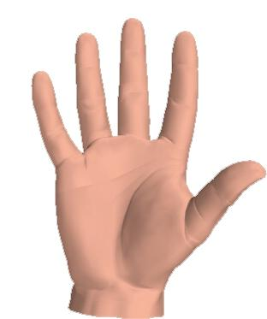
What is proprioception?
the sense of relative position of neighboring parts of the body
Round 2

Slide 64
What is acetylcholinesterase?
an enzyme, present in blood and some nerve endings, that aids the breakdown of acetylcholine (transmitter of nerve impulses) and suppresses its stimulatory effect on nerves
Round 2

Slide 65
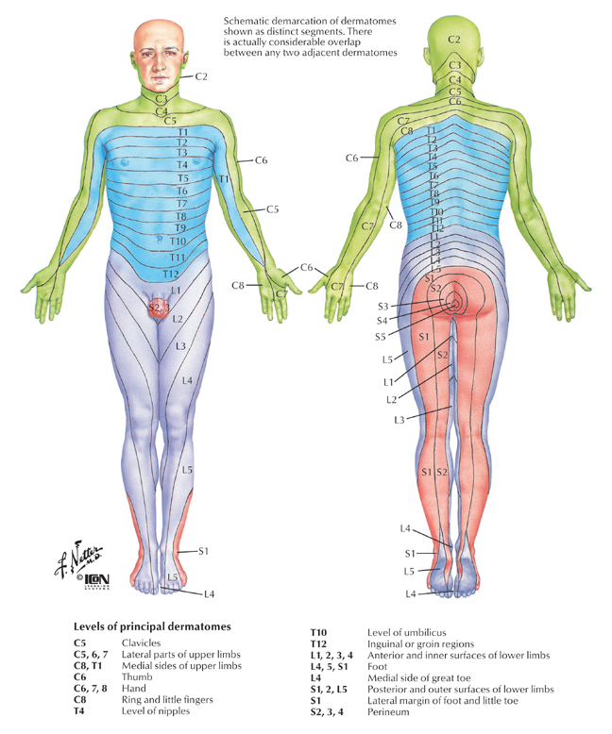
Name a neurotransmitter for the sympathetic and parasympathetic nervous systems.
Acetylcholine (para); norepinephrine (symp)
Round 2

Slide 66
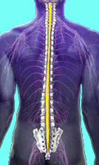
Final Jeopardy Answer Round 2
31 pairs

Slide 67
Final Jeopardy Round 2
How many spinal nerves are there?
More Review

Slide 68
More Review
http://www.anatomyarcade.com/games/gamesNervous.html
http://www.sciencereviewgames.com/srg/subjects/games.php?id=129
http://www.studystack.com/matching-457
http://www.medtrng.com/quia.htm
http://www.reviewgamezone.com/print-auto.php?id=3079

Slide 69
Sources
Cliffs AP Biology 2nd Edition By Phillip Parker
Pearson Education AP Test Prep Series By Fred W. Holtzclaw and Theresa Knapp Holtzclaw
Biology, 7th Edition By Neil A. Campbell and Jane B. Reece
http://www.csuchico.edu/~pmccaffrey/syllabi/CMSD%20320/images/U5MedialView.jpg - picture
http://www.stockmedicalart.com/medicalartlibrary/images/cerebral-cortex.jpg - picture
http://www2.cedarcrest.edu/academic/bio/hale/bioT_EID/lectures/tetanus-neuron.gif - picture
http://www.becomehealthynow.com/images/organs/nervous/brain_stem.jpg - picture
http://universe-review.ca/I10-75-myelin.jpg - picture
http://www.drstandley.com/images/nervous5.bmp - picture
http://www.hdac.org/images/articles/glia.jpg - picture
http://brainmuseum.org/Specimens/primates/human/brain/human8sect6.jpg - pictures
http://www.daviddarling.info/images/blood-brain_barrier.jpg - picture
http://universe-review.ca/I10-82-annelid.jpg - picture
http://www.biologyreference.com/images/biol_03_img0309.jpg - picture
http://www.mult-sclerosis.org/cerebellum.gif - picture
http://www.mult-sclerosis.org/corpuscallosum.gif - picture
http://www.umm.edu/graphics/images/en/19239.jpg - picture
http://www.erichubscher.com/erichubscherpfisite023045.jpg - picture
http://www.bcm.edu/cain_foundation/noframes/html/pages/staff/neurons%20confocal%20mu1a%20dcx.jpg – picture
http://encefalus.com/wp-content/uploads/2008/07/neuron.jpg - picture
http://farm3.static.flickr.com/2292/2294885580_818df74d6f.jpg - picture
http://nyic.stemlegal.com/wp-content/uploads/2009/01/brain-surface-anatomy.jpg - picture
http://nsw.royalsoc.org.au/journal_archive/images/bennett_2/bennett2_fig11.gif - picture
http://www.nebraskabraininjurylawyer.com/images/injuryimages/rough.skull.bones.jpg - picture
http://i.ehow.com/images/a05/e4/ao/treat-mild-sunburn-home-remedy-200X200.jpg - picture
http://www.jonny69.co.uk/images/cheese4.jpg - picture

Slide 70
Sources Continued
http://mslc.rutgers.edu/MovingBodies/Lecture/nervous/nervous_system_study_questions.htm
http://www.backpain-guide.com/Chapter_Fig_folders/Ch06_Path_Folder/Ch06_Images/06-4%20Radiculopathy.jpg – picture
http://www.cure-back-pain.org/images/spinenerve.gif - picture
http://www.chaaps.com/wp-content/uploads/2009/12/hands.jpg - picture
http://www.bio.davidson.edu/courses/genomics/2009/Patel/beforeafterbrain.jpg - picture
http://jankern.files.wordpress.com/2007/09/small-hands-touching.thumbnail.jpg - picture
http://cccncsnl.files.wordpress.com/2007/11/sea-the-light.jpg - picture
http://alaska.usgs.gov/science/biology/remote_sensing/images/sea_ice04.jpg - picture
http://biology.clc.uc.edu/courses/bio105/nervous.htm
http://www.bcm.edu/cain_foundation/noframes/html/pages/staff/growth-cone.gif - picture
http://cristinalaird.files.wordpress.com/2009/06/depression.jpg - picture

